Slide 1

RKMGEC
Cse
2019 - 2023
QUIZ PORTAL
Presented by
MINTU CHAUDHARY (35000119043)
RANJIT TIWARI (35000120073)
AYUSH KESHRI (35000120069)
KOUSHIK HAZRA (35000119008)
ADRIJA MUKHERJEE (35000119026)

Slide 2
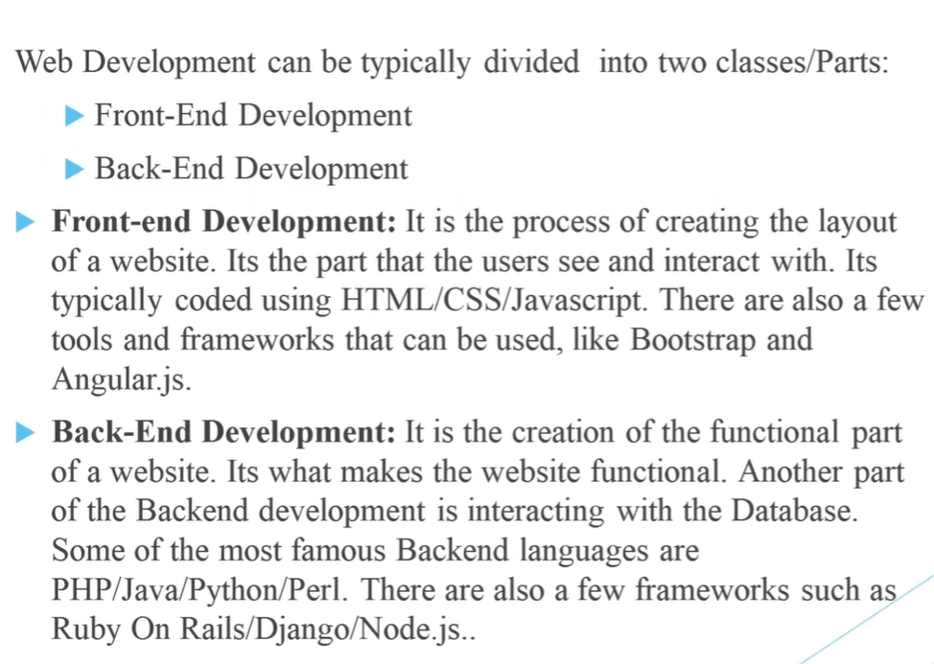

Slide 3
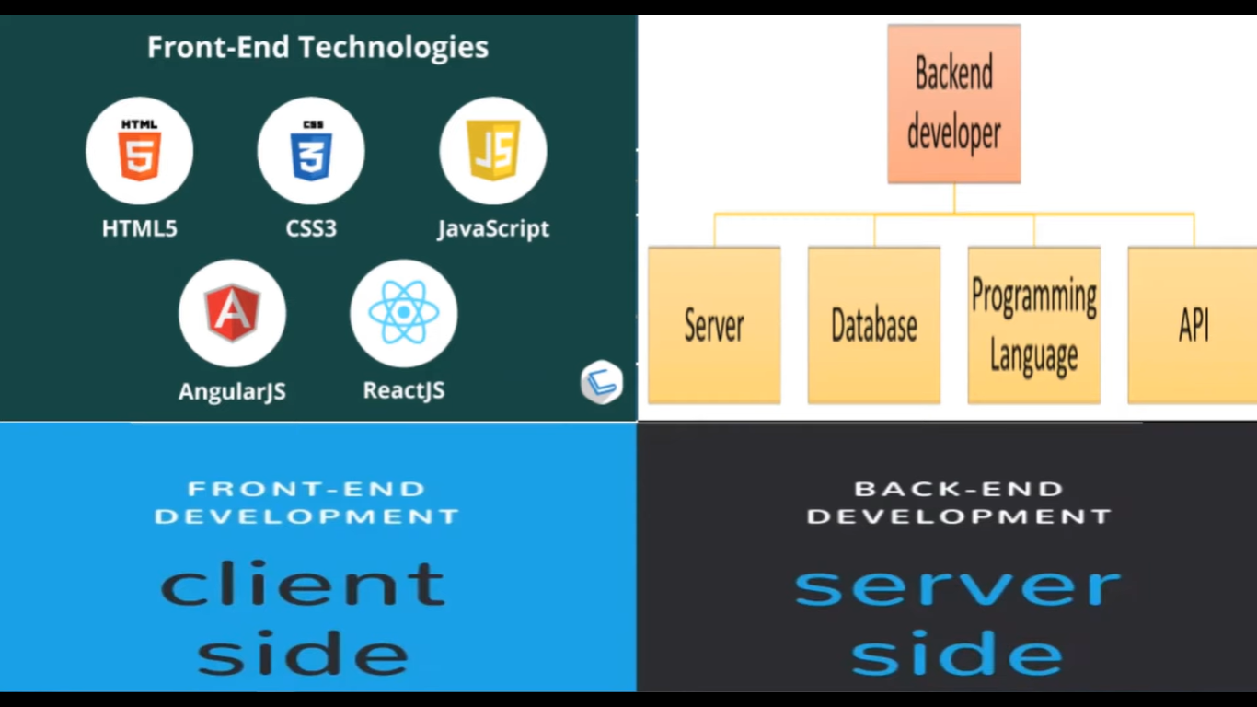

Slide 4
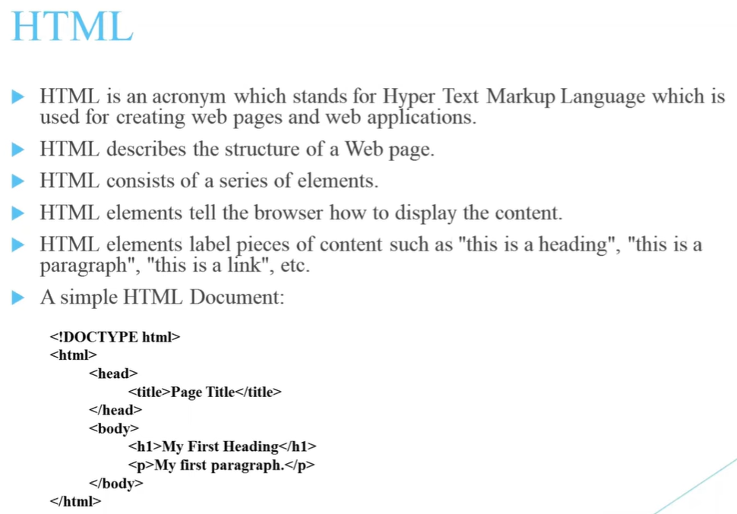

Slide 5
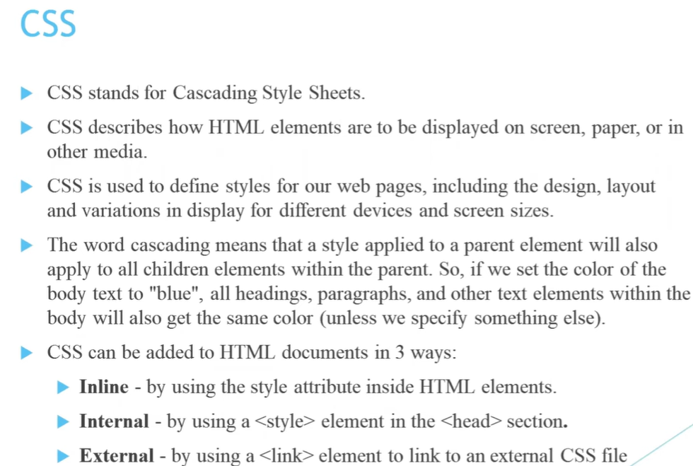

Slide 6
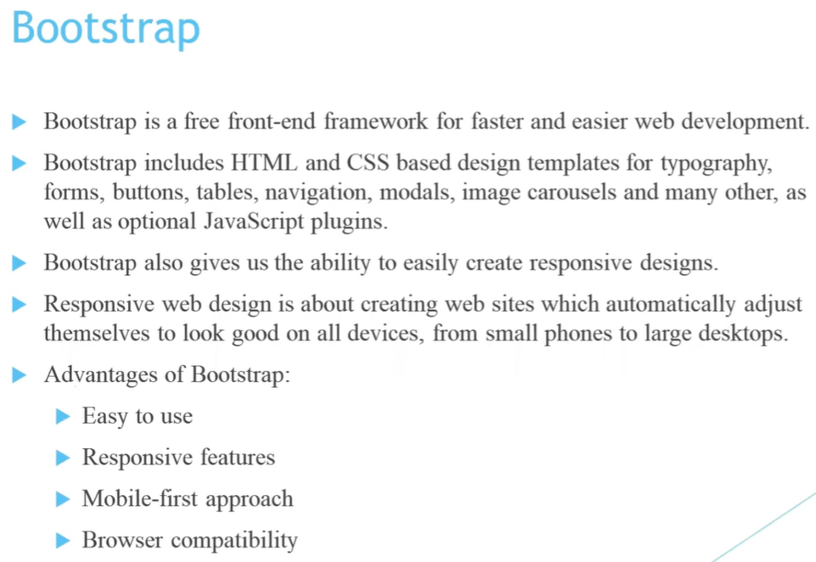

Slide 7
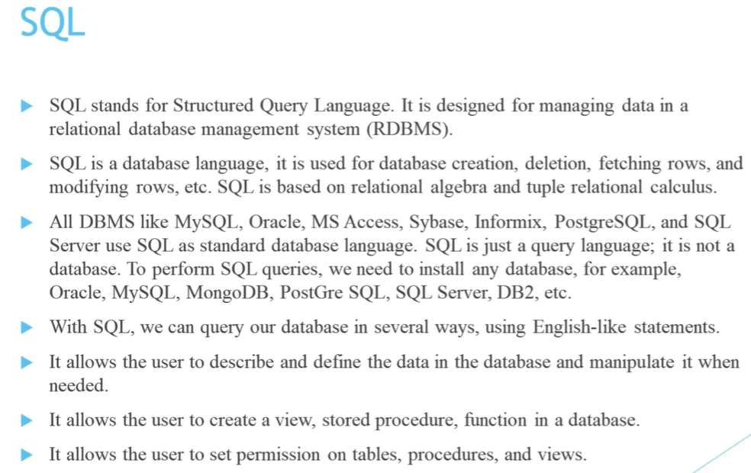

Slide 8
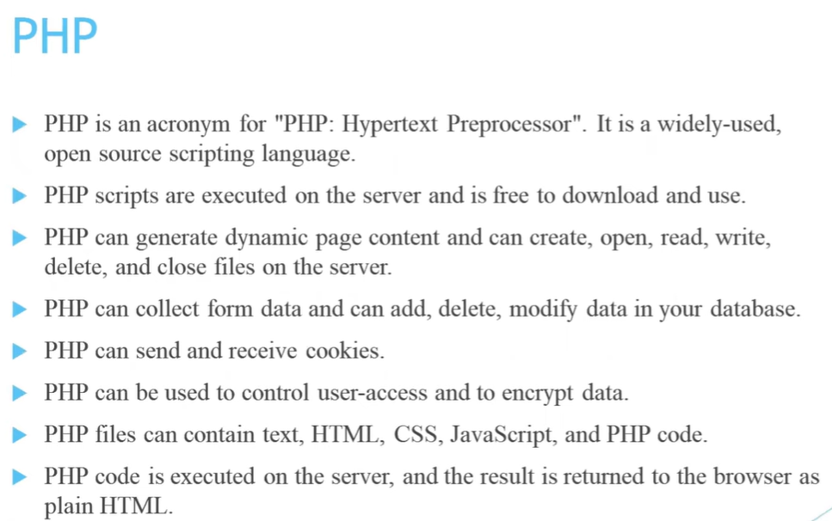

Slide 9
Project details :
Project Name = Quiz portal
Language Used = PHP
Database = MySQL
User Interface Design = HTML, CSS, Bootstrap
Web Browser = Chrome, Opera, etc
Server = Xampp Server

Slide 10
Project Description :
In this project we make a Quiz portal website with Hosting.
The website is consist of HTML, CSS, BOOTSTRAP, PHP and MYSQL code.
The HTML, CSS and BOOTSTRAP part of the code decides how the website looks, while the PHP and MYSQL part decide how it functions.
The main pages that I have designed for the website are :
home.php
about.php
contact.php
Admin.php
register.php
login.php

Slide 11
CODES
<!DOCTYPE html>
<html lang="en">
<head>
<title>Quiz</title>
<meta charset="utf-8">
<meta name="viewport" content="width=device-width, initial-scale=1">
<Link rel="stylesheet" href="style.css"></Link>
<!-- <link rel="stylesheet" href="https://maxcdn.bootstrapcdn.com/bootstrap/3.4.1/css/bootstrap.min.css"> -->
<!-- <script src="https://ajax.googleapis.com/ajax/libs/jquery/3.6.0/jquery.min.js"></script>
<script src="https://maxcdn.bootstrapcdn.com/bootstrap/3.4.1/js/bootstrap.min.js"></script> -->
<link rel="stylesheet" href="https://cdn.jsdelivr.net/npm/bootstrap@4.6.1/dist/css/bootstrap.min.css">
<script src="https://cdn.jsdelivr.net/npm/jquery@3.6.0/dist/jquery.slim.min.js"></script>
<script src="https://cdn.jsdelivr.net/npm/popper.js@1.16.1/dist/umd/popper.min.js"></script>
<script src="https://cdn.jsdelivr.net/npm/bootstrap@4.6.1/dist/js/bootstrap.bundle.min.js"></script>
<script src="alert/dist/sweetalert-dev.js"></script>
<link rel="stylesheet" href="alert/dist/sweetalert.css">
</head>
<body>

Slide 12
<!-- ============================Header Start=================================================== -->
<nav class="navbar navbar-expand-lg navbar-light bg-gray">
<!-----------Logo------------------>
<a class="navbar-brand" href="index.php"><img src="logo.png" style="width:100px;height: auto;"></a>
<a class="navbar-brand" href="index.php">
<h3 style="font-family: cursive;">Tech Quiz</h3>
</a>
<button class="navbar-toggler" type="button" data-toggle="collapse" data-target="#navbarSupportedContent" aria-controls="navbarSupportedContent" aria-expanded="false" aria-label="Toggle navigation">
<span class="navbar-toggler-icon"></span>
</button>
<div class="collapse navbar-collapse" id="navbarSupportedContent">
<ul class="navbar-nav ml-auto topnav">
<li class="nav-item active">
<a class="nav-link" href="index.php">Home <span class="sr-only">(current)</span></a>
</li> <li class="nav-item signIn">
<a class="nav-link btn " type="button" href="#" data-toggle="modal" data-target="#myModal" style="color:black;">Sign In</a>
</li>
<li class="nav-item register">
<a class="nav-link btn " type="button" href="#" data-toggle="modal" data-target="#myModal2" style="color:black;">Register</a>
</li>

Slide 13
<li class="nav-item">
<a class="nav-link text-dark" href="Contact.html">Contact us</a>
</li>
<li class="nav-item">
<a class="nav-link text-dark" href="About us.html">About us</a>
</li>
<li class="nav-item">
<a class="nav-link text-dark" href="login.php">Admin</a>
</li>
</ul>
</div> <!-- The Modal -->
<div class="modal fade" id="myModal">
<div class="modal-dialog">
<div class="modal-content">
<!-- Modal Header -->
<div class="modal-header">
<h4 class="modal-title">Sign In</h4>
<button type="button" class="close" data-dismiss="modal">×</button>
</div>
<form action="logincontroller.php" method="post" onsubmit="return validation1()">

Slide 14
<!-- Modal body -->
<div class="modal-body">
<div class="form-group">
<label class="sr-only" for="usrname">Username</label>
<div class="input-group mb-3">
<div class="input-group-prepend">
<span class="input-group-text" id="basic-addon1"><i class="fa fa-user"></i></span>
</div>
<input type="text" class="form-control" name="username" placeholder="Username" aria-label="Username" aria-describedby="basic-addon1" id="user1" autocomplete="off">
</div>
<span id="username1" class="text-danger font-weight-bold"></span>
</div> <div class="form-group">
<label class="sr-only" for="Password">Name</label>
<div class="input-group mb-2">
<div class="input-group-prepend">
<span class="input-group-text" id="basic-addon2"><i class="fa fa-key"></i></span>
</div>
<input type="Password" type="password" name="password" class="form-control" placeholder="Password" aria-label="Password" aria-describedby="basic-addon2" id="pass1">
</div>
<span id="passwords" class="text-danger font-weight-bold"></span>
</div> </div>

Slide 15
<!-- Modal footer -->
<div class="modal-footer">
<button type="submit" class="btn btn-primary">Sign In</button>
<button type="button" class="btn btn-danger" data-dismiss="modal">Close</button>
</div>
</form> </div>
</div>
</div> <!-- The Modal -->
<div class="modal fade" id="myModal2">
<div class="modal-dialog">
<div class="modal-content"> <!-- Modal Header -->
<div class="modal-header">
<h4 class="modal-title">Register</h4>
<button type="button" class="close" data-dismiss="modal">×</button>
</div>
<form action="validation.php" method="post" onsubmit="return validation()">
<!-- Modal body -->
<div class="modal-body">
<div class="form-group">
<label class="sr-only">Username</label>
<div class="input-group mb-3">
<div class="input-group-prepend">
<span class="input-group-text" id="basic-addon1"><i class="fa fa-user"></i></span>
</div>

Slide 16
<input type="text" name="username" autocomplete="off" class="form-control" placeholder="Create Username" aria-label="Username" aria-describedby="basic-addon1" id="user">
</div>
<span id="username" class="text-danger font-weight-bold"></span>
</div>
<div class="form-group">
<label class="sr-only">Password</label>
<div class="input-group mb-2">
<div class="input-group-prepend">
<span class="input-group-text" id="basic-addon2"><i class="fa fa-key"></i></span>
</div>
<input type="Password" type="password" name="password" class="form-control" placeholder="Create Password" aria-label="Password" aria-describedby="basic-addon2" id="pass">
</div>
<span id="password1" class="text-danger font-weight-bold"></span>
</div>
<div class="form-group">
<label class="sr-only">Password2</label>
<div class="input-group mb-2">
<div class="input-group-prepend">
<span class="input-group-text" id="basic-addon3"><i class="fa fa-key"></i></span>
</div>

Slide 17
<input type="Password" type="password" name="password2" autosave="off" class="form-control" placeholder="Re-enter Password" aria-label="Password" aria-describedby="basic-addon2" id="pass2">
</div>
<span id="password2" class="text-danger font-weight-bold"></span>
</div>
</div>
<!-- Modal footer -->
<div class="modal-footer">
<button type="submit" class="btn btn-primary">Register</button>
<button type="button" class="btn btn-danger" data-dismiss="modal">Close</button>
</div>
</form>
</div>
</div>
</div>
</nav>
<!-- ====================================Header End===================================== -->

Slide 18
<!-- ==================================5 images sliding====================================== -->
<div class="container-fluid sliding">
<div id="demo" class="carousel slide" data-ride="carousel"> <!-- Indicators -->
<ul class="carousel-indicators">
<li data-target="#demo" data-slide-to="0" class="active"></li>
<li data-target="#demo" data-slide-to="1"></li>
<li data-target="#demo" data-slide-to="2"></li>
<li data-target="#demo" data-slide-to="3"></li>
<li data-target="#demo" data-slide-to="4"></li>
</ul> <!-- The slideshow -->
<div class="carousel-inner">
<div class="carousel-item active">
<img src="images/1.png" alt="Los Angeles" width="1000" height="400">
</div>
<div class="carousel-item">
<img src="images/2.png" alt="Chicago" width="1000" height="400">
</div>
<div class="carousel-item">
<img src="images/3.png" alt="New York" width="1000" height="400">
</div>
<div class="carousel-item">
<img src="images/4.png" alt="New York" width="1000" height="400">
</div>

Slide 19
<div class="carousel-item">
<img src="images/5.png" alt="New York" width="1000" height="400">
</div>
</div> <!-- Left and right controls -->
<a class="carousel-control-prev" href="#demo" data-slide="prev">
<span class="carousel-control-prev-icon"></span>
</a>
<a class="carousel-control-next" href="#demo" data-slide="next">
<span class="carousel-control-next-icon"></span>
</a>
</div>
</div>
<!--=============================Sliding End=========================================--> <!--==============================description===========================================-->
<br>
<div class="container-fluid description mt-0 mb-0" style="background-color: whitesmoke;height: 500px;">
<div class="row">
<div class="col-12">
<p> An Online Exam Portal is a technology based assessment creation that allows you to give exams anywhere. …………………………………………………..
………………………………………………….. </p>
</div> </div> </div>
<!--=============================description End============================================-->

Slide 20
<!---Copyright Section-->
<footer>
<center>
<p class="copyright">Copyright Tech Quiz 2022<br>
<a href="index.php">Home |</a>
<a href="Contact.html">Contact Us |</a>
<a href="About us.html">About us </a>
</p>
</center>
</footer>
<script type="text/javascript">
function validation()
{
var user=document.getElementById('user').value;
if(user=="")
{
document.getElementById('username').innerHTML="** please fill the username field";
return false;
}
if((user.length<=2) || (user.length>20))
{
document.getElementById('username').innerHTML="** user length must be between 2 and 20";
return false;
}

Slide 21
if(!isNaN(user))
{
document.getElementById('username').innerHTML="** Number are not allowed";
return false;
}
var pass = document.getElementById('pass').value;
if(pass=="") {
document.getElementById('password1').innerHTML="** please fill the password";
return false;
}
if((pass.length<=5) || (pass.length>20)) {
document.getElementById('password1').innerHTML="** password length must be between 5 & 20";
return false;
}
var pass2= document.getElementById('pass2').value;
if(pass2=="") {
document.getElementById('password2').innerHTML="** please confirm the password";
return false; }
if(pass != pass2) {
document.getElementById('password2').innerHTML="** password are not matching";
return false;
}
alert("Wow! Succesfully Register");
}

Slide 22
</script>
<script type="text/javascript">
function validation1()
{
//for login
var user1=document.getElementById('user1').value;
if(user1=="")
{
document.getElementById('username1').innerHTML="** username can not be blank";
return false;
}
var pass1= document.getElementById('pass1').value;
if(pass1=="")
{
document.getElementById('passwords').innerHTML="** password can not be blank";
return false;
}
}
</script>
</body>
</html>

Slide 23
BACK-END
←----------------------------------------------Register-----------------------------------------------→
<?php
session_start();
$con = mysqli_connect('localhost','root');
mysqli_select_db($con, 'techquiz');
$name = $_POST['username'];
$pass = $_POST['password'];
$pass2 = $_POST['password2'];
$q =" select * from register where username = '$name' && password = '$pass'";
$result =mysqli_query($con,$q);
$num =mysqli_num_rows($result);
if($num==1)
{
echo ("<script LANGUAGE='JavaScript'>
window.alert('Duplicate Data');
window.location.href='index.php';
</script>");
}

Slide 24
else
{
$qy="insert into register(username ,password ,password2) values('$name','$pass','$pass2')";
mysqli_query($con,$qy);
header('refresh:0,url=index.php');
}
?>
←-------------------------------------------------------login-------------------------------------------------------→
<?php
session_start();
$con = mysqli_connect('localhost','root');
mysqli_select_db($con, 'techquiz');
$name = $_POST['username'];
$pass = $_POST['password'];
$q =" select * from register where username = '$name' && password = '$pass'";
$result =mysqli_query($con,$q);
$num =mysqli_num_rows($result);

Slide 25
if($num==1)
{
$_SESSION['username'] = $name;
header('location:Terms & Conditions.html');
}
else
{
echo ("<script LANGUAGE='JavaScript'>
window.alert('Invalid username and password ');
window.location.href='index.php';
</script>");
}
?>

Slide 26
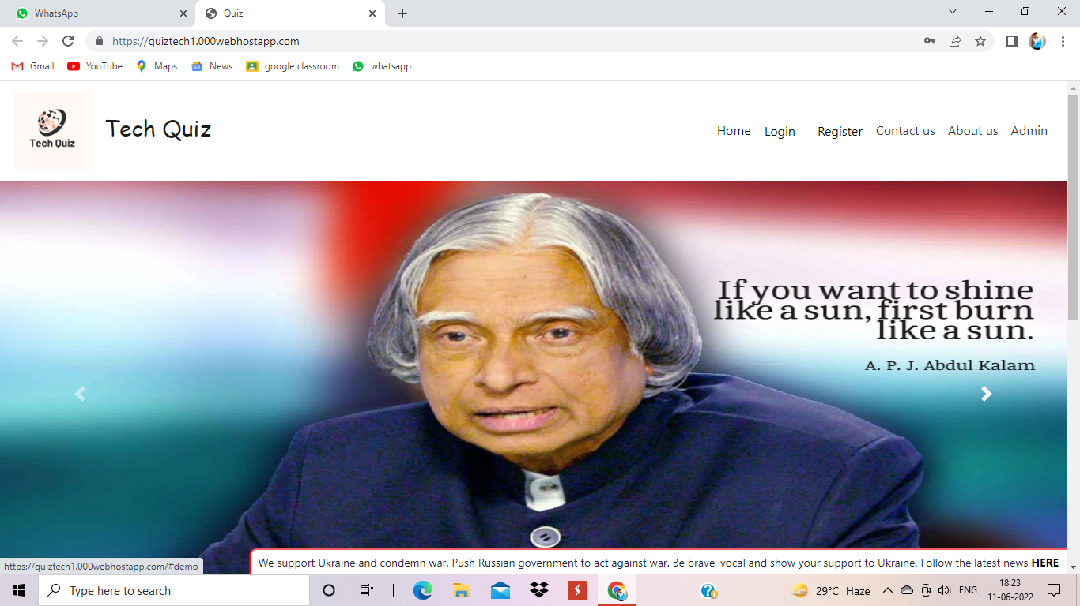

Slide 27
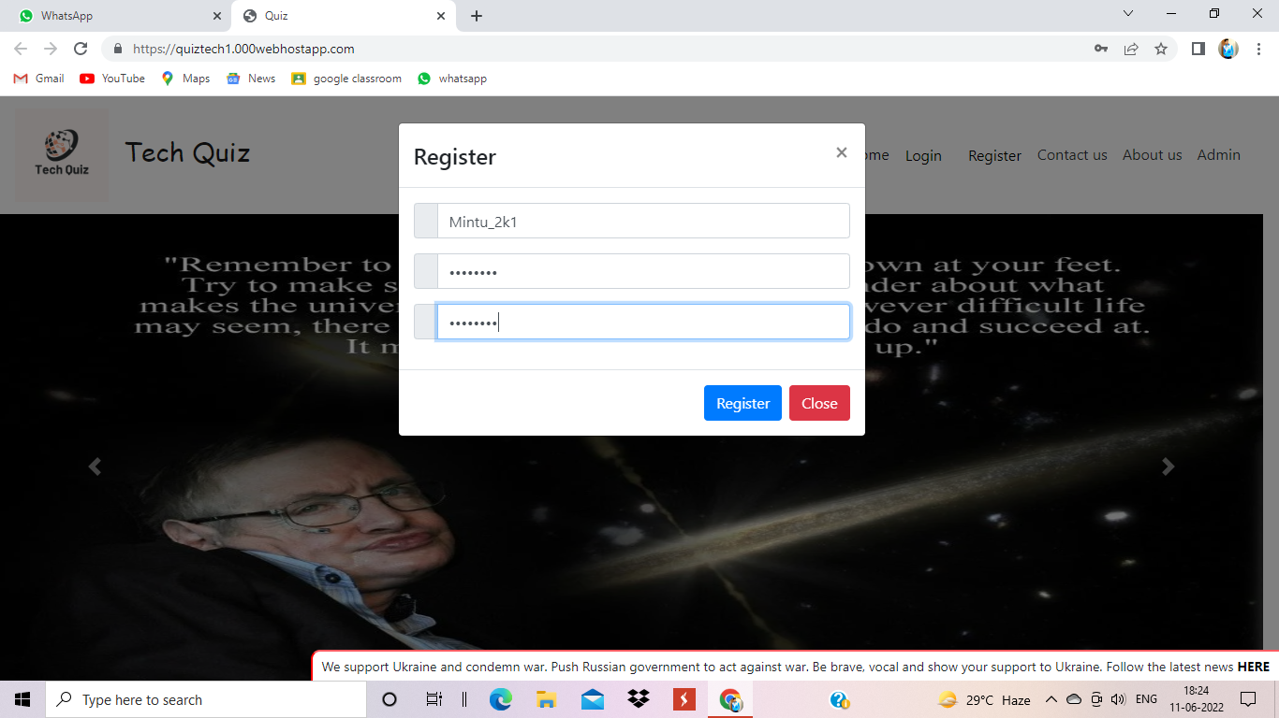

Slide 28
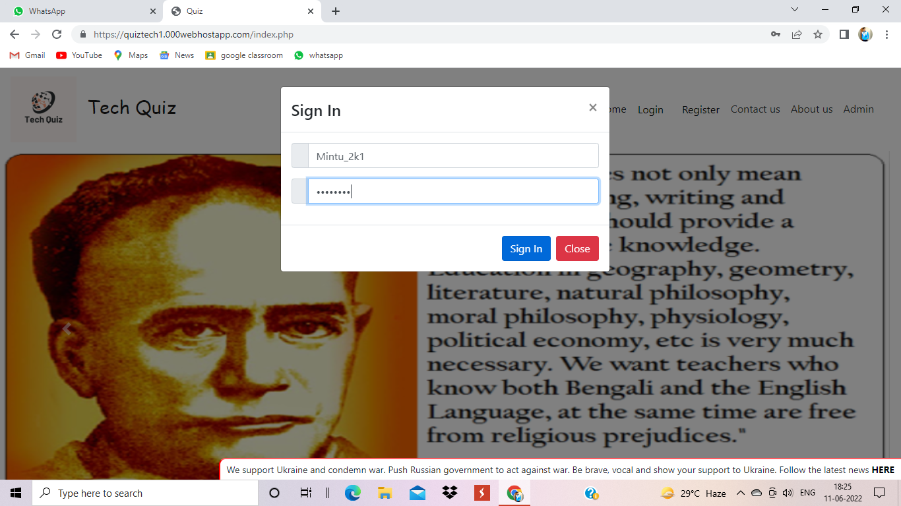

Slide 29
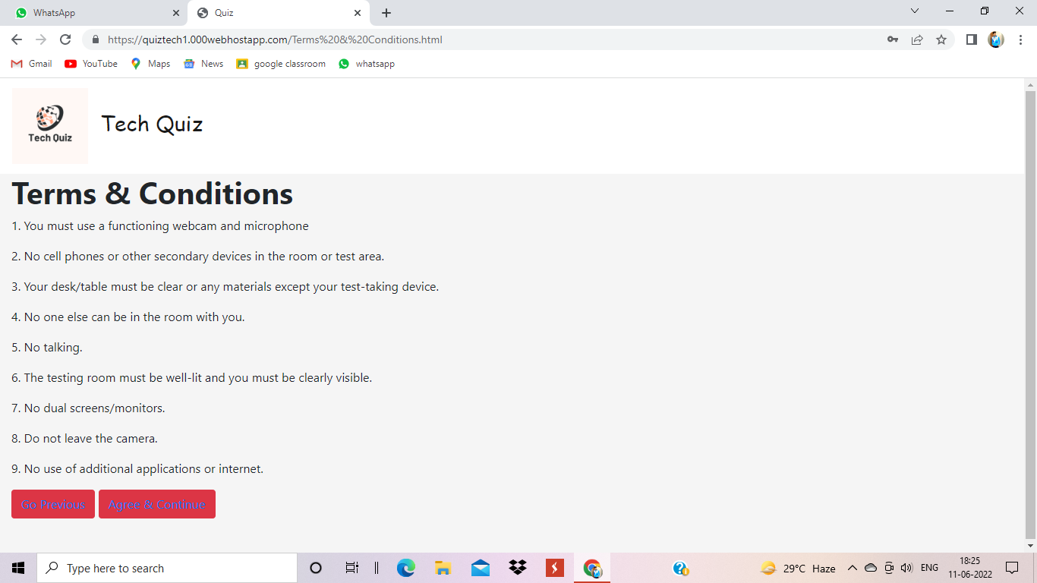

Slide 30
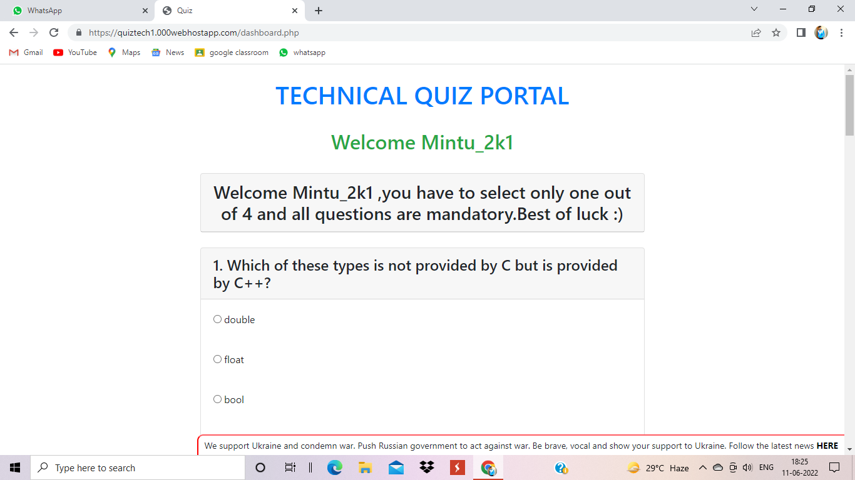

Slide 31
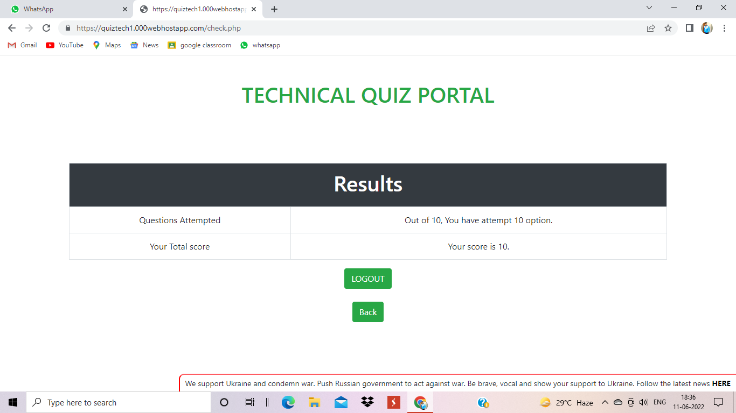

Slide 32
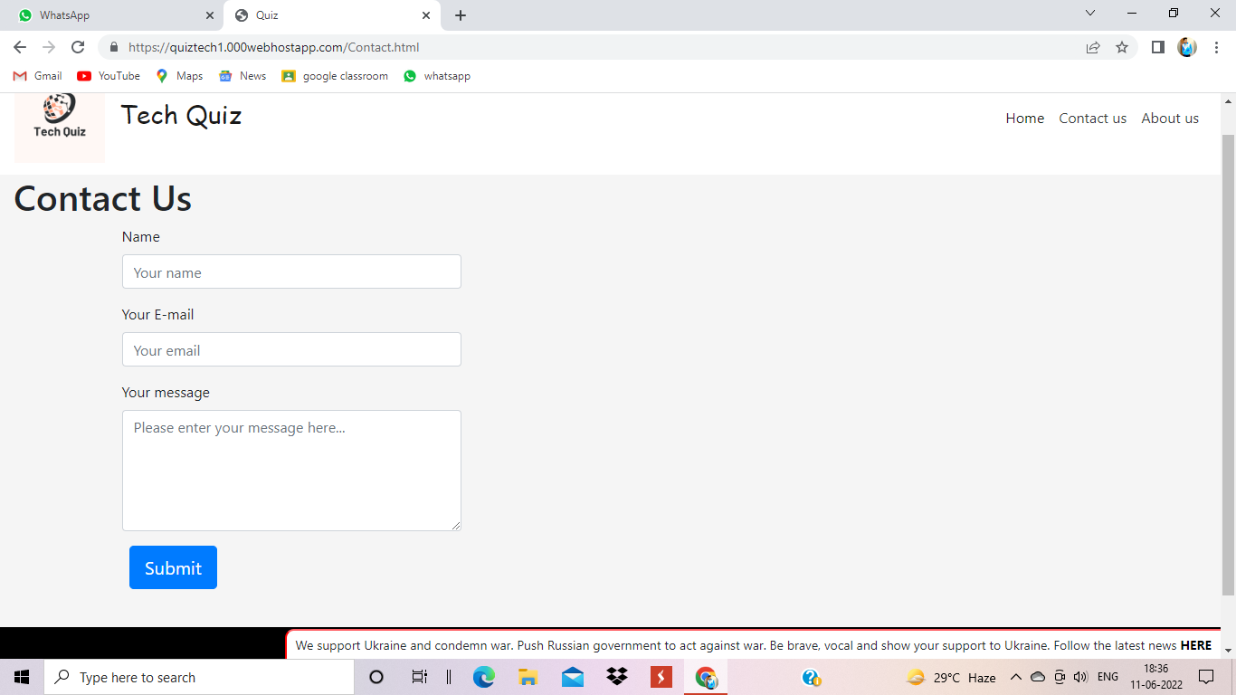

Slide 33
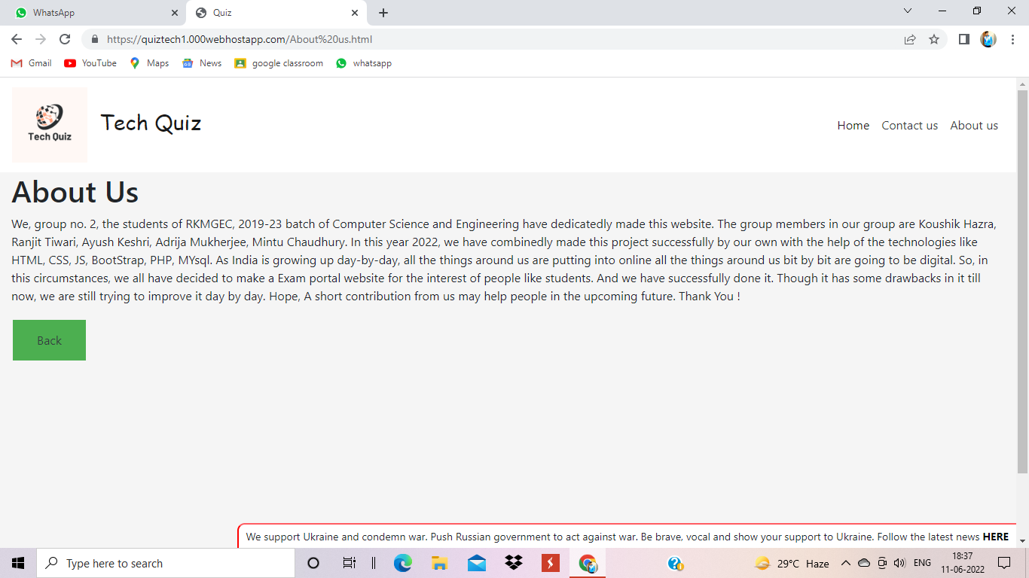

Slide 34
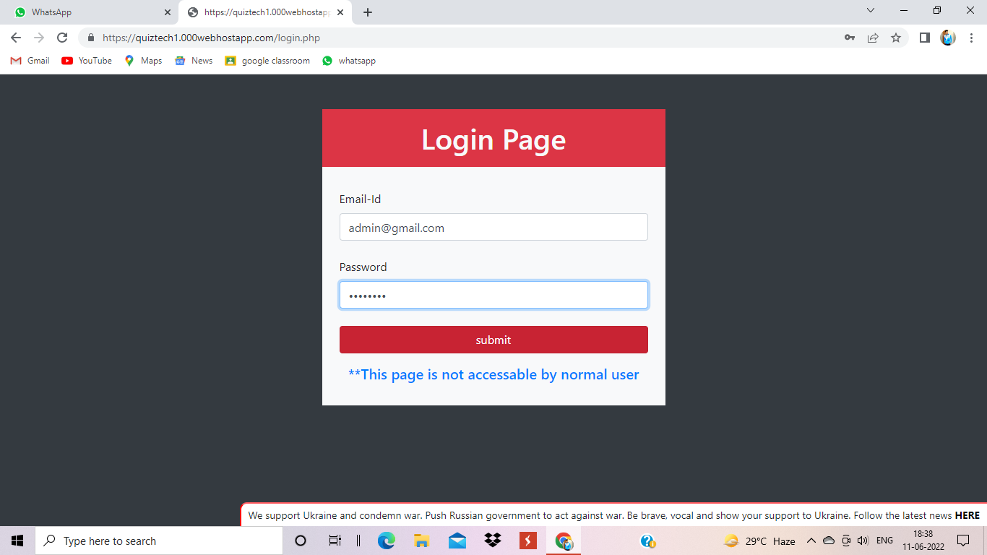

Slide 35
CONCLUSION
We have tried our best to complete this project work successfully. Amidst a pleasure environment of constant cooperation and remarkable guidance.
This online quiz system provides facility to conduct online examination world wide. It saves time as it allows number of students to give the exam at a time and displays the results as the test gets over, so no need to wait for the result. It is automatically generated by the server. Administrator has a privilege to create, modify and delete the test papers and its particular questions. User can register, login and give the test with his specific id, and can see the results as well.

Slide 36


